Slide 1

Chapter 11
Core Collection Classes
KGiSL Microcollege
KGiSL Campus, Saravnampatti,Coimbatore - 641035

Slide 2
Table of Contents
1. Core Collection Classes .................................................................................... 4
1.1 The Collections Framework ...............................................................................4
1.2 The Set Interface................................................................................................7
1.3 Set Implementation Classes...............................................................................9
1.4 List Interface ....................................................................................................12
1.5 List Implementation classes.............................................................................14
1.6 The Queue Interface .......................................................................................15
1.7 Queue Implementation Classes .......................................................................17
1.8 Map Interface...................................................................................................21

Slide 3

11
CORE COLLECTION CLASSES
Chapter 11
Core Collection Classes

Slide 4
11
CORE COLLECTION CLASSES
Chapter 11: Core Collection Classes
In the following chapter we are going to learn about the core collection classes. The various interfaces such as the set, list, map, queue interfaces are discussed in detail. Their implementation classes are also discussed here.

Slide 5
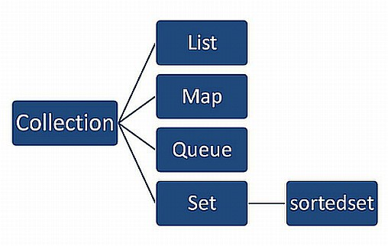
11
CORE COLLECTION CLASSES
Core Collection Classes
The Collections Framework
The collection framework defines several interfaces. Starting with the collection interfaces is needed, as it is the fundamental of the collection class.
Core Collection Interface
Colletion Interface List interface
list Set Interface Sorted Set
Enables group of objects; it is base class.
Extends Collection interface to handle sequence of the objects
Extends collection to handle sets.
Extends Set class for sorted set.
A core collection interface summarizes various types of collections. This core collection interfaces are the foundation of the java collection framework.
Collection - This is super class of all classes, it represents group of objects which are elements. Collection interface is the foundation upon which the collections framework is built.
List - It is an ordered collection. It can contain duplicate elements. The integer index is used for elements inserted and it is used to access the elements.

Slide 6

11
CORE COLLECTION CLASSES
Queue - A collection used to hold multiple elements. A queue provides an additional insertion, extraction and inspection operations.
Set - this collection cannot have duplicate elements. This interface models the mathematical set abstraction.
Sorted Set - Extends set interface.
Advantage of collections framework
Collection framework codes are more flexible to write and use. You can use many classes and interfaces of the framework.
You can implement many interfaces.
It has standard set of interfaces. It increases the readability of your collections.
Collection framework interface’s are very easy to use.
Collection Interface\
Collection interface declares the core methods. It represents group of objects called elements. It is used to pass the objects.
boolean add(Object o)
This method is used to add the object, if Boolean values are true the object will be added to invoking collection. If Boolean value is false the object value already in the collection.
boolean equal(Object o)
This method is used to check whether the objects are equal or not. If the Boolean value is true collection and objects are equal else not equal.
void clear()
This method is used to remove all the elements from the invoking collection.
int hasCode()
This hashcode method is used to return the hash code for invoking collection.
boolean contains(Object o)
The boolean returns true if the objects is an element of the invoking collection, else the object is not an element of the invoking collection.

Slide 7
11
CORE COLLECTION CLASSES
boolean containsAll(Object o)
When the boolean value is true the invoking collection contains all elements, else Boolean returns false.
boolean remove(object o)
This method is used to remove the instance of the object from invoking collection. The boolean value returns true when all the elements have been removed, else not removed.
boolean removeAll(Collection c)
This method is used to remove all collection elements from the invoking collection. The Boolean value returns true if all elements are removed, else not removed.
boolean retainAll(Collection c)
collection c cannot remove from the invoking collection. The boolean value is true to retain the removed object, else not retained.
Interface nothing but class, we can create our own interface and implement in our class, example program is given below.
Example
interface:
interface inter
{
public void meth(); public void show();
}
Implements in class
public class ex implements inter
{
int a,b,c;
public void meth()
{

Slide 8
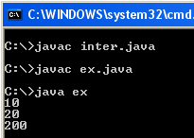
11
CORE COLLECTION CLASSES
a=10;
b=20;
c=a*b;
}
public void show()
{
System.out.println(a); System.out.println(b); System.out.println(c);
}
public static void main(String arg[])
{
ex ob=new ex(); ob.meth();
ob.show();
}
}
Output
1.2 The Set Interface
Set interface extends the collection interface. It defines a set. It has behaviour of collection that does not allow duplicate elements. Set interface contains only methods inherited from collection interface.
Methods are:

Slide 9
11
CORE COLLECTION CLASSES
add()
The add() method used to add an objects to the collection.
clear()
clear() method is used to remove all objects from the collection.
remove()
remove() method different from the clear() method, it removes only specified objects from the collection.
size()
size() method is used to return the size or the elements in the collection.
boolean isEmpty()
boolean returns true if the collection has no elements, else return false.
iterator()
return the iterator object for the collection.
Example
import java.util.*;
class ExampleHash
{
public static void main(String arg[])
{
Set<String> hs=new TreeSet<String>();
hs.add("ICT");
hs.add("Acadamy");
hs.add("Welcome");
System.out.println("Using Treeset add()"+hs); hs.remove("ICT");
System.out.println("Using Treeset remove()"+hs); hs.size();

Slide 10
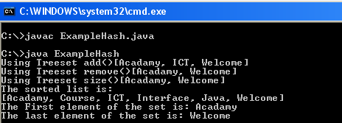
11
CORE COLLECTION CLASSES
System.out.println("Using Treeset size()"+hs); hs.add("ICT");
hs.add("Acadamy");
hs.add("Welcome");
hs.add("Java");
hs.add("Course"); hs.add("Interface");
TreeSet ts=new TreeSet<String>(hs);
System.out.println("The System.out.println(ts); System.out.println("The "+(String)ts.first()); System.out.println("The "+(String)ts.last());
}
}
sorted list is:");
First element of the set is:
last element of the set is:
Output
1.3 Set Implementation Classes
Framework provides three implementations classes. They are: HashSet, TreeSet and LinkedHashSet.
HashSet: This is a class; it is used to store the elements in hash table and cannot store the duplicate elements in collections. Hashset class allows to store the null elements for add,

Slide 11
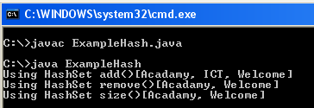
11
CORE COLLECTION CLASSES
remove, size. This null element is used to perform basic operations. This is the best way to perform set interface.
Example
import java.util.*; class ExampleHash
{
public static void main(String arg[])
{
Set<String> hs=new HashSet<String>(); hs.add("ICT");
hs.add("Acadamy");
hs.add("Welcome");
System.out.println("Using hs.remove("ICT"); System.out.println("Using hs.size(); System.out.println("Using
}
}
HashSet add()"+hs);
HashSet
remove()"+hs);
HashSet
size()"+hs);
Output

Slide 12
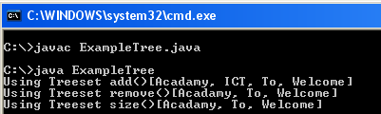
11
CORE COLLECTION CLASSES
TreeSet: It is used to extract elements from a collection. The elements added to a treeset are sortable in an order. It is faster to add element to a hashset, then converting the elements of the collection to a treeset.
Example
import java.util.*; class ExampleTree
{
public static void main(String arg[])
{
TreeSet<String> ts=new TreeSet<String>(); ts.add("Welcome");
ts.add("To");
ts.add("ICT");
ts.add("Acadamy");
System.out.println("Using ts.remove("ICT"); System.out.println("Using ts.size(); System.out.println("Using
}
}
Treeset add()"+ts);
Treeset
remove()"+ts);
Treeset
size()"+ts);
Output

Slide 13
11
CORE COLLECTION CLASSES
LinkedHashSet: this is a class. Whose implementation differs from Hashset class, because it implements both the hashtable and linked list implementation of the set interface. It uses insertion order insert elements into set.
List Interface
A list is defined as an ordered collection. It can be accessed by an index where the indices are zero based. A list has methods for inserting & removing elements. It can contain duplicate elements. It provides us an iterator which allows us to move backwards and forward through the elements.
The following are the three methods in which a list can be modified:
Add an element
Remove an element
Replace an element
List Methods Positional methods
Get(int index) | Returns the element at the specified position
Set(int index, Object element) | replaces the element at the specified position with the given object
Add(int index, object element) | Inserts the specified element at the specified position, shifting all the elements and adds one to their index values
Remove(int index) | Removes the elements at the specified position shifting all the elements and subtracting one from their indices.

Slide 14
11
CORE COLLECTION CLASSES
Search methods
indexOf(Object o) | returns the index of the first occurence of the specified element or -1 if it is not found
lastIndexOf(Object o) | returns the index of the last occurence of the specified element or -1 if it is not found
List iterator
listIterator() | returns a list iterator of the elements in their proper sequence
listIterator(int index) | returns a list iterator of elements starting at the specified index
subList(int fromIndex, int toIndex) | returns the portion of the list between the specified indices exclusive of the toIndex element
Example program
import java.util.*;
public class ExampleList
{
public static void main(String args[])
{
int i[]={24, 12,30,40,70};
List <Integer>al = new ArrayList<Integer>(); Try
{
for(int a=0; a<5; a++)

Slide 15
11
CORE COLLECTION CLASSES
{
al.add(i[a]);
}
System.out.println("The List is: "); System.out.println(al);
LinkedList <Integer>que = new LinkedList<Integer>(); for(int a=0; a<5; a++)
{
que.addFirst(i[a]);
}
System.out.println("The Queue is: "); System.out.println(que);
que.removeLast();
System.out.println("Removed List"+ que);
}
catch(Exception e)
{
System.exit(0);
}
}}
Last Element in the
List Implementation classes
There are three types of list implementation classes . they are
Array List
Linked List
RunArray List

Slide 16
11
CORE COLLECTION CLASSES
Array List:
It extends AbstractList implements List. It is Cloneable, Serializable. Here the elements are ordered. It uses an array internally to store elements. Accessing index is faster while adding and removing elements, except at the end of the array which is expensive.
Linked List
It extends AbstractSequentialListimplements List, Cloneable,Serializable. Here the elements are ordered. It uses doubly linked list internally to store elements. Adding or removing
elements involves updating two links. Accessing index is slow as the entire list must be traversed. Linked list retains a reference to both the first and the last elements,hence retrieving first or last element is efficient.
The Queue Interface
Queue interface extends the collection interface. It holds the elements prior to processing. Queues provides additional insertion(add) objects, removal(remove) objects. Holding elements in a FIFO(first in first out) process concept. This FIFO concept is queue the element inserts first and also remove the first element.
Each Queue method exists in two forms:
Throws an exception if the operation fails, and
Returns a special value if the operation fails (either null or false)
Methods :
offer(e)-add(e)
This add method is used to add an element in the queue. It orders the elements using FIFO method.
peek() -element()
This method is used to return an element, if queue is empty it returns null value. The element and peek methods return, but do not remove, the head of the queue. If the queue is empty, element throws NoSuchElementException, while peek returns null.

Slide 17
11
CORE COLLECTION CLASSES
poll() -remove()
This method is used to remove elements from the queue, The remove and poll methods both remove and return the head of the queue. The remove and poll methods differ in their behavior only when the queue is empty. Under these circumstances, remove throws NoSuchElementException, while poll returns null.
Example
import java.util.*; public class ExampleQueue
{
public static void main(String[] args)throws InterruptedException
{
int que = Integer.parseInt(args[0]); Queue<Integer> ls = new LinkedList<Integer>(); for (int i = que; i >= 0; i--)
ls.add(i);
while (!ls.isEmpty())
{
System.out.println(ls.remove()); Thread.sleep(500);
System.out.println("Queue is Working");
} }
}

Slide 18
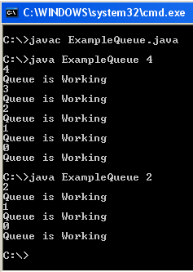
11
CORE COLLECTION CLASSES
Output
1.7 Queue Implementation Classes
The framework provides implementation classes:
ArrayList :
In this arraylist class inherit from util class. Java.utilArraList. The arraylist object is used to ad ding and removing objects. Arraylist provide the methods to manipulate the size of array that is use to store the list.
ArrayList class extends AbstracList and implements the List interface and Serializable interface.
ArrayList can increase this capacity automatically. It is not synchronized it is allow all objects including null.
ArrayList provides three methods:
add(Object obj), size() and remove(int index)

Slide 19
11
CORE COLLECTION CLASSES
Example
import java.util.*; class ExampleArrayList
{
public static void main(String args[])
{
ArrayList<String> al = new ArrayList<String>(); System.out.println("Array List Size: " +al.size()); System.out.println("Adding Object to ArrayList");
al.add("C");
al.add("A");
al.add("E");
al.add("B");
al.add("D");
al.add("F"); System.out.println("Size
+al.size());
al.add(1, "A2"); System.out.println("Size
+al.size());
al.remove("F");
of al after additions: "
of al after Alter Array: "
al.remove(2);System.out.println("ArrayList Object from the List: " +al.size()); System.out.println("Contents of al: " + al);
}
}
after
Delete

Slide 20
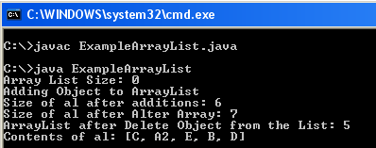
11
CORE COLLECTION CLASSES
Output
LinkedList
This class extends Java.Util class. This class creates an object to performing variuous functions like adding and removing objects.
This class extends AbstractSequentialList and implemetns List interface and Serializable interface.
Methods are:
add(Object obj) method is used to adding the elements to the list.
addFirst(Object obj) adding the element at the first place of the list.
addLast(Object obj) adding the elements at the last place of the list.
remove(int index) remove the elements from the list.
size() return size of the list.
Example
import java.util.*;
class ExampleLinkedList
{
public static void main(String args[])
{
LinkedList<String> ls = new LinkedList<String>();

Slide 21

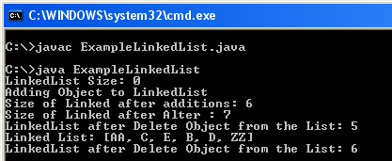
11
CORE COLLECTION CLASSES
System.out.println("LinkedList Size: System.out.println("Adding Object to ls.add("C");
ls.add("A");
ls.add("E");
ls.add("B");
ls.add("D");
ls.add("F");
" +ls.size()); LinkedList");
System.out.println("Size
+ls.size());
ls.addFirst("AA"); System.out.println("Size
+ls.size());
ls.remove("F"); ls.remove(2);
of Linked after additions: "
of Linked after Alter : "
System.out.println("LinkedList after the List: " +ls.size());
ls.addLast("ZZ");
Delete
Object
from
System.out.println("Linked List: " + ls); System.out.println("LinkedList after Delete the List: " +ls.size());
}
}
Object
from
Output

Slide 22
11
CORE COLLECTION CLASSES
1.8 Map Interface
A map is an object that maps keys and values or key/value pairs.
If a key is given the values can be found. Both the keys and values are objects. Some maps may accept null key and null values while others cannot. The map interface maps unique
keys to values. A key is an object that we use to retrieve a value at a later date.
Method | Description
Void clear() | Removes all key/ value pairs from the invoking map
Boolean containsKey(Object k) | Returns true if the invoking map contains k as a key. Otherwise, returns false
Boolean contains value(object v) | Returns true if the map contains v as value. Otherwise , returns false.
Set entrySet() | Returns a set that contains the entries in the map. The set contains objects of type Map.Entry. This method provides a set-view of the invoking map.
Boolean equals(Object obj) | Returns true if obj is a map and contains the same entries. Otherwise, returns false.
Set keyset() | Returns the value associated with the key k
Int hashCode() | Returns the hash code for the invoking map.
Int size() | Returns the number of key/ value pairs in the map.
Map. Entry Interface
It enables us to work with a map entry. Every element in a map has a key and a value. Every key value pair is saved in a java.util.map.entry object. These antries can be obtained by calling a map’s entryset() method.

Slide 23
11
CORE COLLECTION CLASSES
Sorted map Interface
A special map interface used to maintain elements in an order is called sorted map interface.
It maintains its elements in ascending order. It is similar to sort set except, the sort is done on map keys. It provides two methods, they are
firstkey()
lastkey()
The first key() returns first value ie the lowest value currently in the map while the lastkey() method returns the last value ie the highest value in the map.
Example program
import java.util.*; public class ExampleMap
{
public static void main(String args[])
{
String days[]={"Sunday",
"Monday", "Tuesday", "Saturday"};
"Wednesnday","Thursday", "Friday",
Map<Integer, String>();
Try
{
String> map = new HashMap<Integer,
for(int i=0; i<7; i++)
{
map.put(i, days[i]);
}

Slide 24
11
CORE COLLECTION CLASSES
TreeMap<Integer, String> tm=new TreeMap<Integer, String>(map);
System.out.println("Keys of tree map: " + tm.keySet());
System.out.println("Values of tree map: " + tm.values());
System.out.println("First key: " + tm.firstKey()
+" Value: " + tm.get(tm.firstKey()) + "\n"); System.out.println("Removing first data: " +
tm.remove(tm.firstKey()));
System.out.println("Now the tree map Keys: " + tm.keySet());
System.out.println("Now the tree map contain: " + tm.values() + "\n");
System.out.println("Last key: " + tm.lastKey() +" Value: " + tm.get(tm.lastKey()) + "\n");
System.out.println("Removing last data: " + tm.remove(tm.lastKey()));
System.out.println("Now tm.keySet());
System.out.println("Now tm.values());
}
catch(Exception e)
{
the tree map Keys: " +
the tree map contain: " +
System.exit(0);} }}

Slide 25
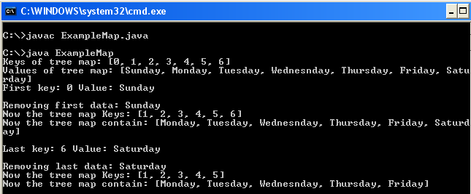
11
CORE COLLECTION CLASSES
Output
Map Implementation classes:
The map implementation classes are
Abstract map- implements all map interface
Hash map- Extends AbstractMap to use a hash table
Tree map- Extends Abstract Map to use a tree
Weak hash map- Extends Abstractmap to use a hash table with weak keys.
The hash map is mainly used for some basic operations like inserting, deleting and locating elements in a map. A hash map has two factors that affects its performance
Initial capacity
Load factor
The capacity is the number of buckets in hash table and the initial capacity is the capacity at the time the hash table is created. Load factor is a measure of how full the hash table is allowed to get before its capacity is increased. When the entries exceed the capacity is
increased by calling the rehash method. The following constructors are defined:
HashMap()
HashMap(Map m)
HashMap(int capacity)
HashMap(int capacity,float fillRatio)

Slide 26
11
CORE COLLECTION CLASSES
The hashmap() constructs a default hash map.The hashMap(Map m) initializes the hash map by using the elements of m. The Hashmap(int capacity) initializes the capacity of the hash map to capacity. The Hashmap(int capacity,float fillRatio) initializes both the capacity and the fill ratio of the hash map by using its arguments.
Tree map class
When we wish to transverse the keys in a sorted manner the tree map class is used. The elements added to tree map must be sortable. It depends on the size of the specified collection. It may be faster to add elements to a hashmap, then convert the map to a tree map for traversing the sorted arrays.
The following tree map constructors are defined:
TreeMap()
TreeMap(Comparator comp)
TreeMap(Map m)
TreeMap(SortedMap sm)
An empty tree map is constructed that will be sorted using the natural order of the keys in the first one. In the second one the empty tree based map is sorted using comparator comp. The third form initializes a tree map with entries form m. The fourth one initializes a tree map with the entries from sm, which will be sorted in the same order as sm.
Exercise
Write a program to find area of a rectangle using interface
Write a program to show multiple inheritance using interface in college system.
Write a program to show how to access interface variables

Slide 27
11
CORE COLLECTION CLASSES
Summary
In the above chapter we have discussed about the core collection classes in java. The topics discussed here are
List interface
Set interface
Map interface
Queue interface
Collection classes

